Slide 1






Lecture 27:
React Hooks Overview - State Management with useState
Course - Web Development - II
-By
Instructor Name
welcome@krmangalam.edu.in
Sohna Road,Gurugram,Haryana 122103

Slide 2

| Table of Contents
React Hook
Introduction to React State.
Managing Component State with useState.
Updating State & Re-rendering.
References.
The End.

Slide 3
| What is React Hook?
React Hooks are special functions in React that allow you to use state and lifecycle features in functional components.
Hooks were introduced in React 16.8.
Before Hooks, these features were only available in class components.
Example Hooks
useState → Manage state
useEffect → Handle side effects

Slide 4

|
Imagine you have a lunchbox that can be empty, half-full, or full. How would you keep track of its current state throughout the day?

Slide 5
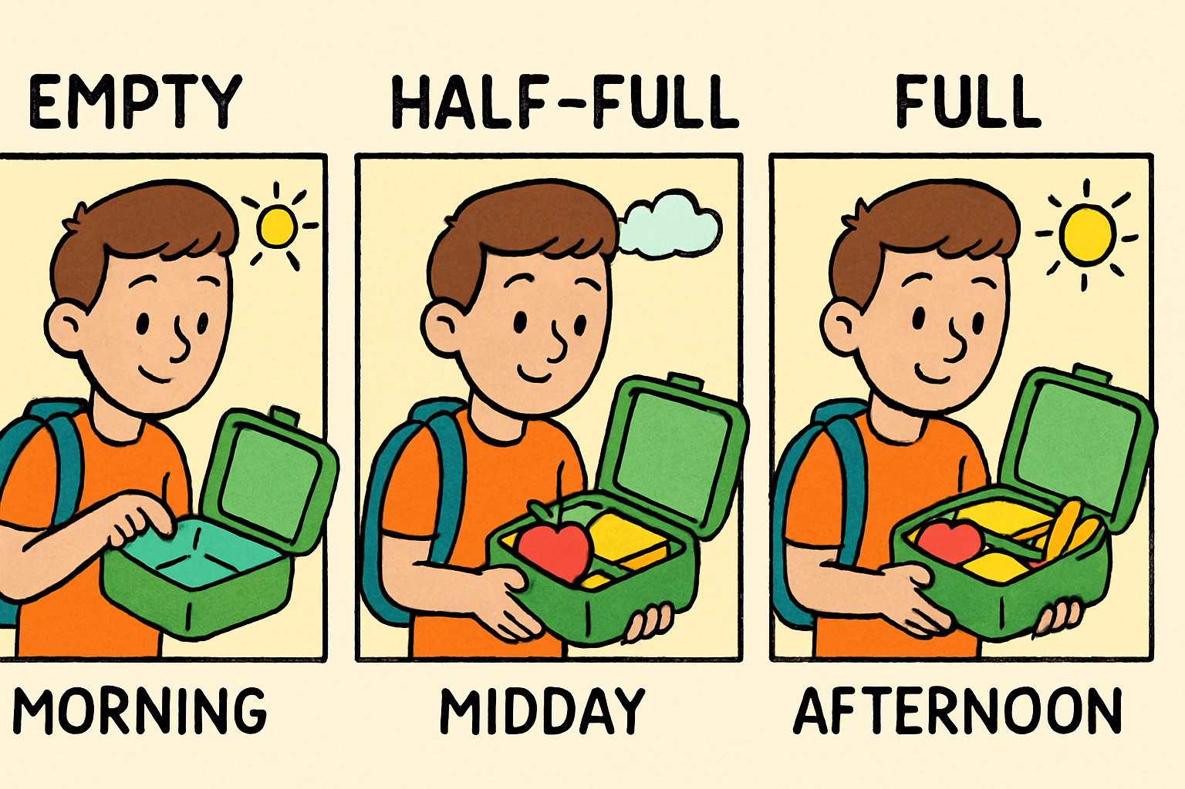
|
Imagine you have a lunchbox that can be empty, half-full, or full. How would you keep track of its current state throughout the day?
To keep track of your lunchbox's state throughout the day, you start by setting an initial state (e.g., empty), update it whenever the lunchbox changes (half-full, full), and use that state to show the current status.
In React, this is like using state to remember and update dynamic data inside a component.

Slide 6
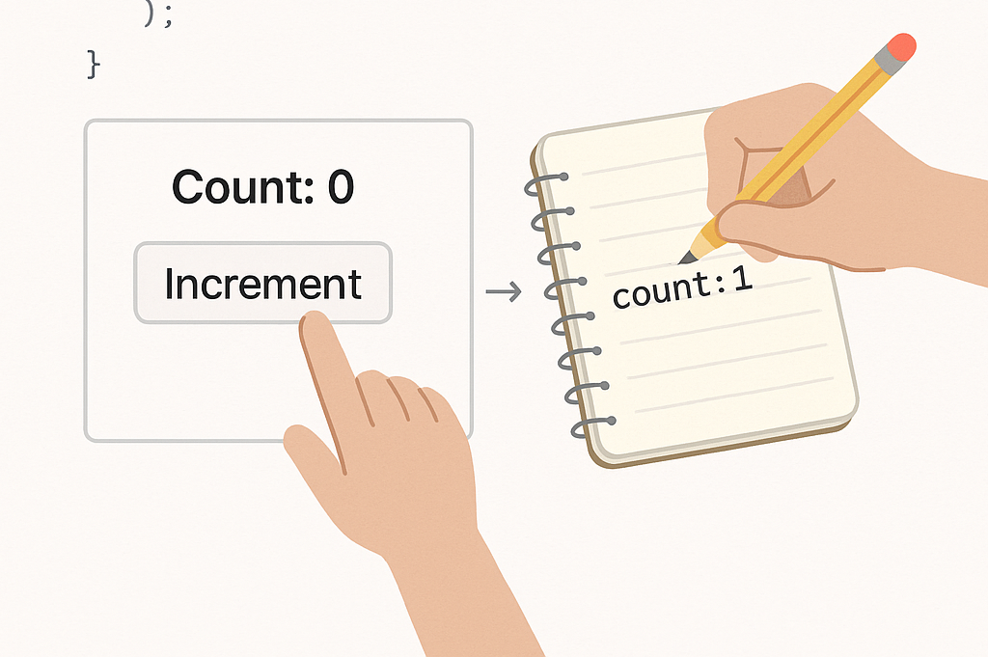
| Introduction to React State
React State is a built-in feature in React that allows components to store and manage dynamic data. It represents values that can change over time due to user interaction, system events, or internal logic.
When state changes, React automatically re-renders the component to reflect the new data in the UI.

Slide 7
| Introduction to React State
Key Points
Each React component can have its own state.
When the state changes, React re-renders the component updating the UI.
State can only be updated using special functions (not directly).
You manage state using the useState() hook in functional components.

Slide 8
| Why do we need React State
To store changing data in a component.
To respond to user actions (like clicks or typing).
To update the UI automatically when data changes.
Makes the app dynamic and interactive.

Slide 9

|
Imagine you have a light switch in your room that you can flip on or off. How do you keep track of whether the light is currently on or off?

Slide 10
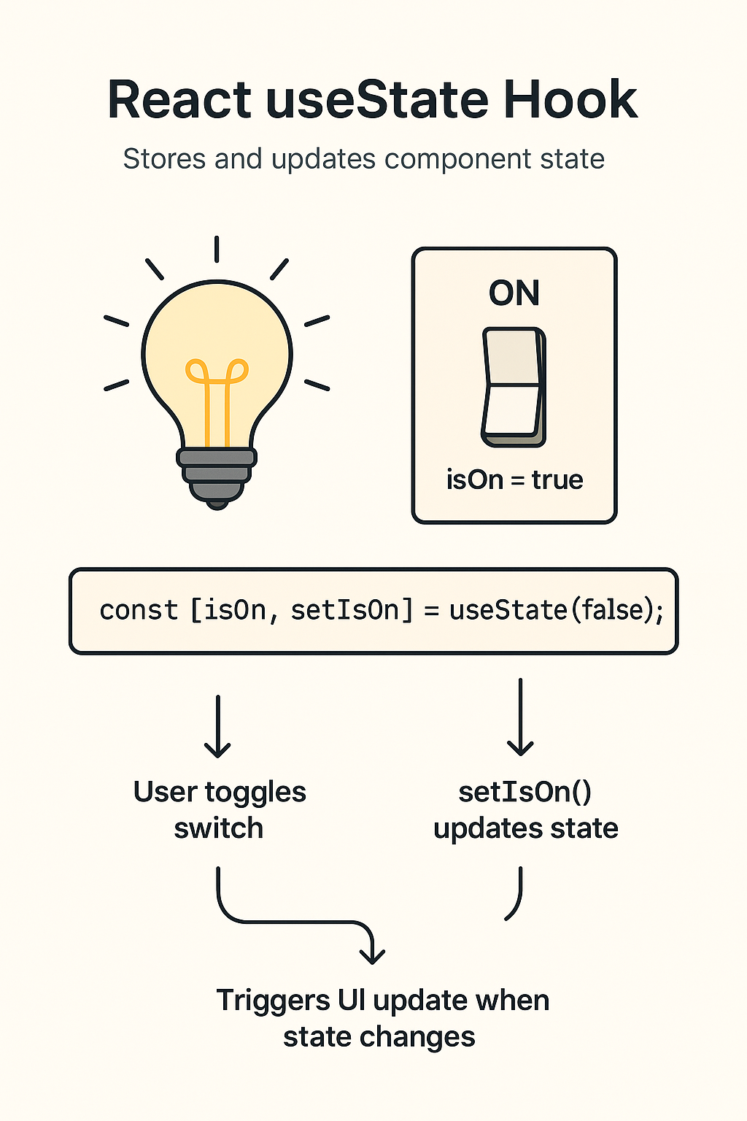
|
Imagine you have a light switch in your room that you can flip on or off. How do you keep track of whether the light is currently on or off?
To keep track of whether a light switch is on or off, you store its current status as a true (on) or false (off) value.
In React, the useState() hook does the same by initializing a state variable (like isOn), updating it when toggled, and re-rendering the UI to show the current light status.

Slide 11
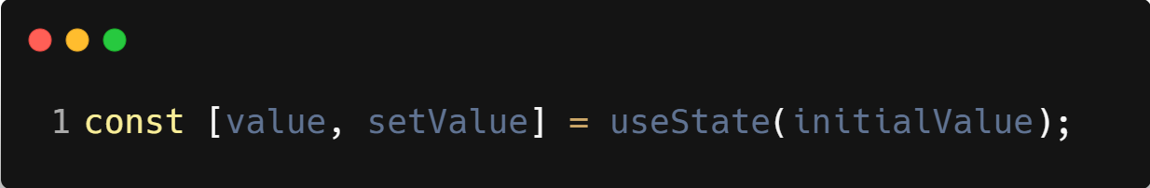
| useState()
useState() is a React Hook that lets you add state (a way to store changing data) to your functional components.
It lets your component remember values — like a counter, a form input, or toggle state.
When the state changes, React automatically re-renders the component to reflect the new value in the UI.
Syntax :

Slide 12
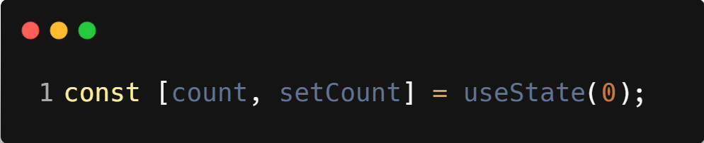
| useState()
Example :
count → the current state value
setCount() → function to update that value
0 → the initial value of count
Key Points:
It comes from React: import { useState } from 'react'
It can be used multiple times to track different values
You must not update state directly — always use the updater function (setCount)

Slide 13
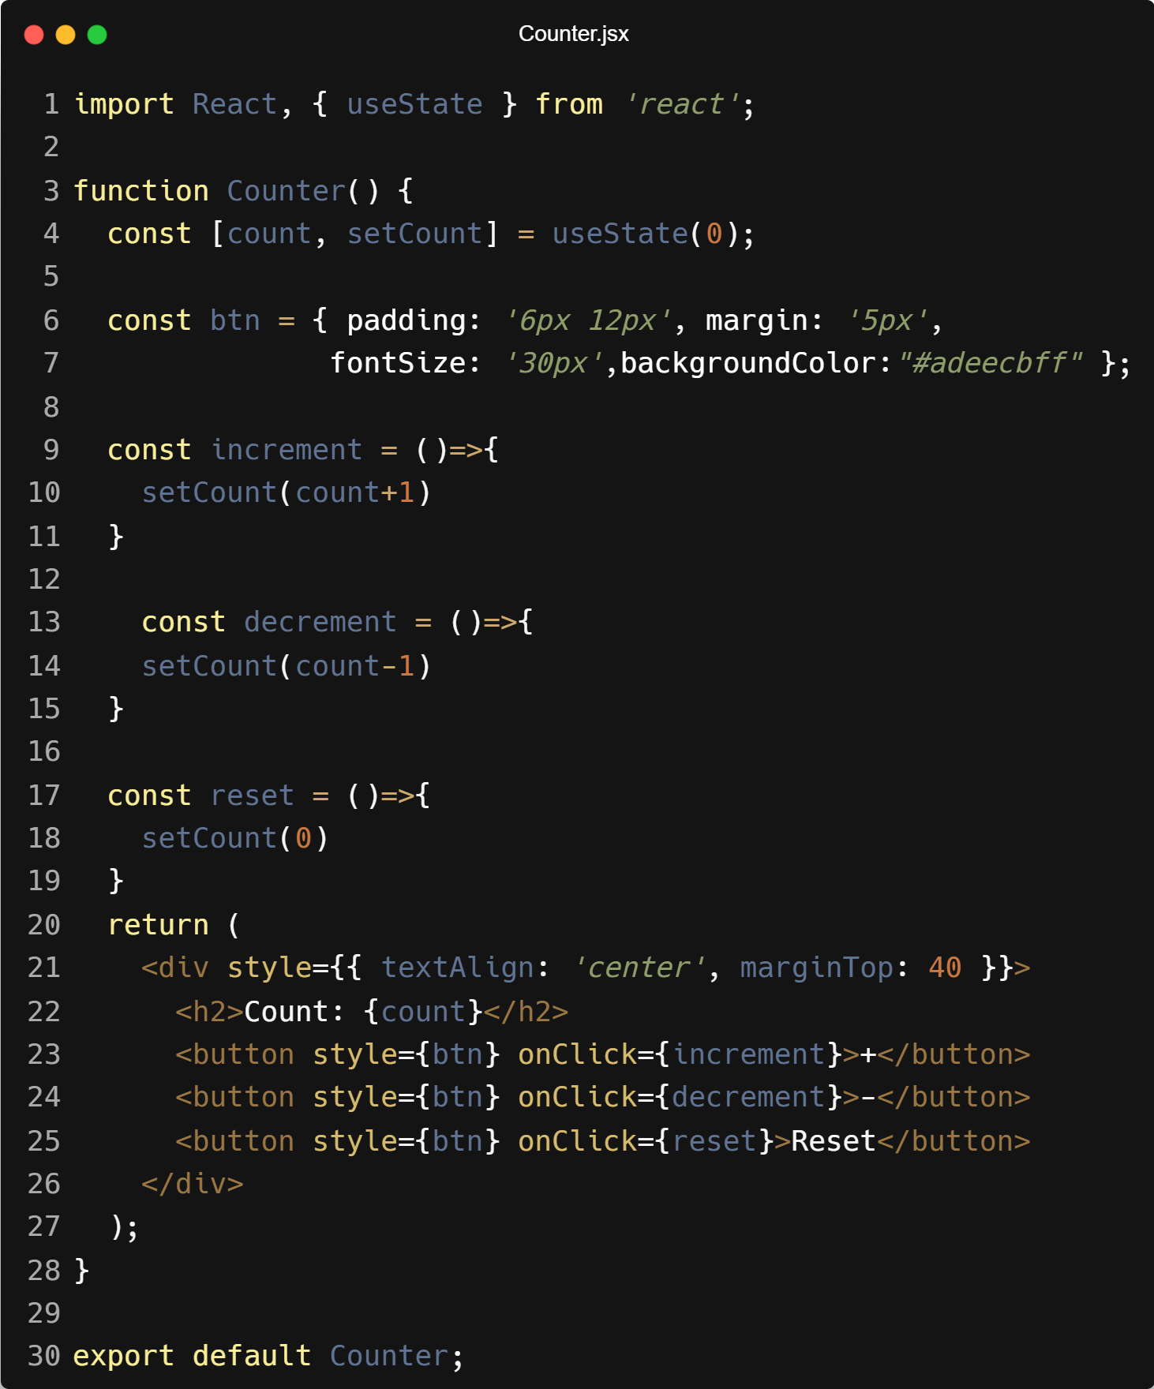
| Example

Slide 14
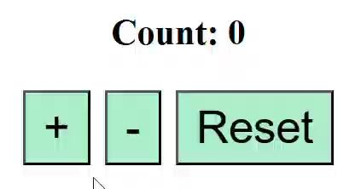
| Output

Slide 15
| Updating State & Re-Rendering
1. useState is Used to Store Count
Initializes a state variable count with value 0.
setCount is the function used to update count.

Slide 16
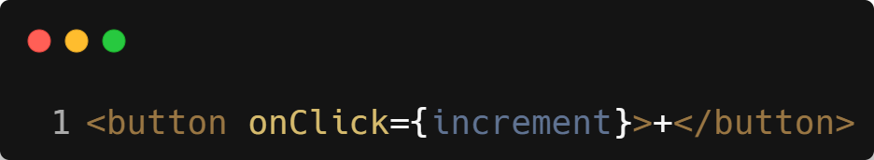
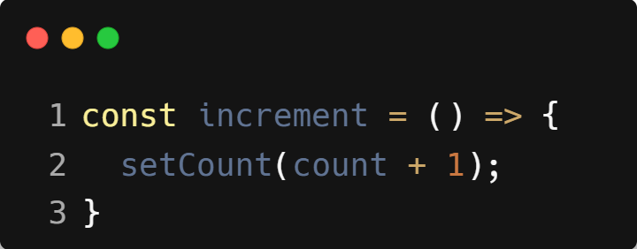
| Updating State & Re-Rendering
2. User Clicks a Button (e.g., + or -)
When clicked, it runs this:

Slide 17
| Updating State & Re-Rendering
3. State is Updated
setCount updates the value of count.
For example, if count was 0, it becomes 1.
4. React Re-renders the Component
React sees the state has changed.
It automatically re-runs the component to refresh the UI.

Slide 18
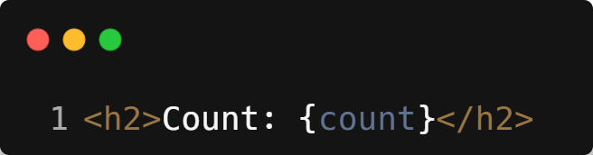
| Updating State & Re-Rendering
5. Updated UI is Displayed
Now displays the updated number, like Count: 1.
This Cycle Repeats
Every time a button is clicked (increment, decrement, reset):
setCount() updates the state.
React re-renders the component.
UI reflects the latest value of count.

Slide 19

| Coding Questions
1. Simple Counter
Task :
Create a Counter component. Use the useState Hook to manage a count state variable, initialized to 0. Display the current count in a <p> tag and a <button> that, when clicked, increments the count.

Slide 20
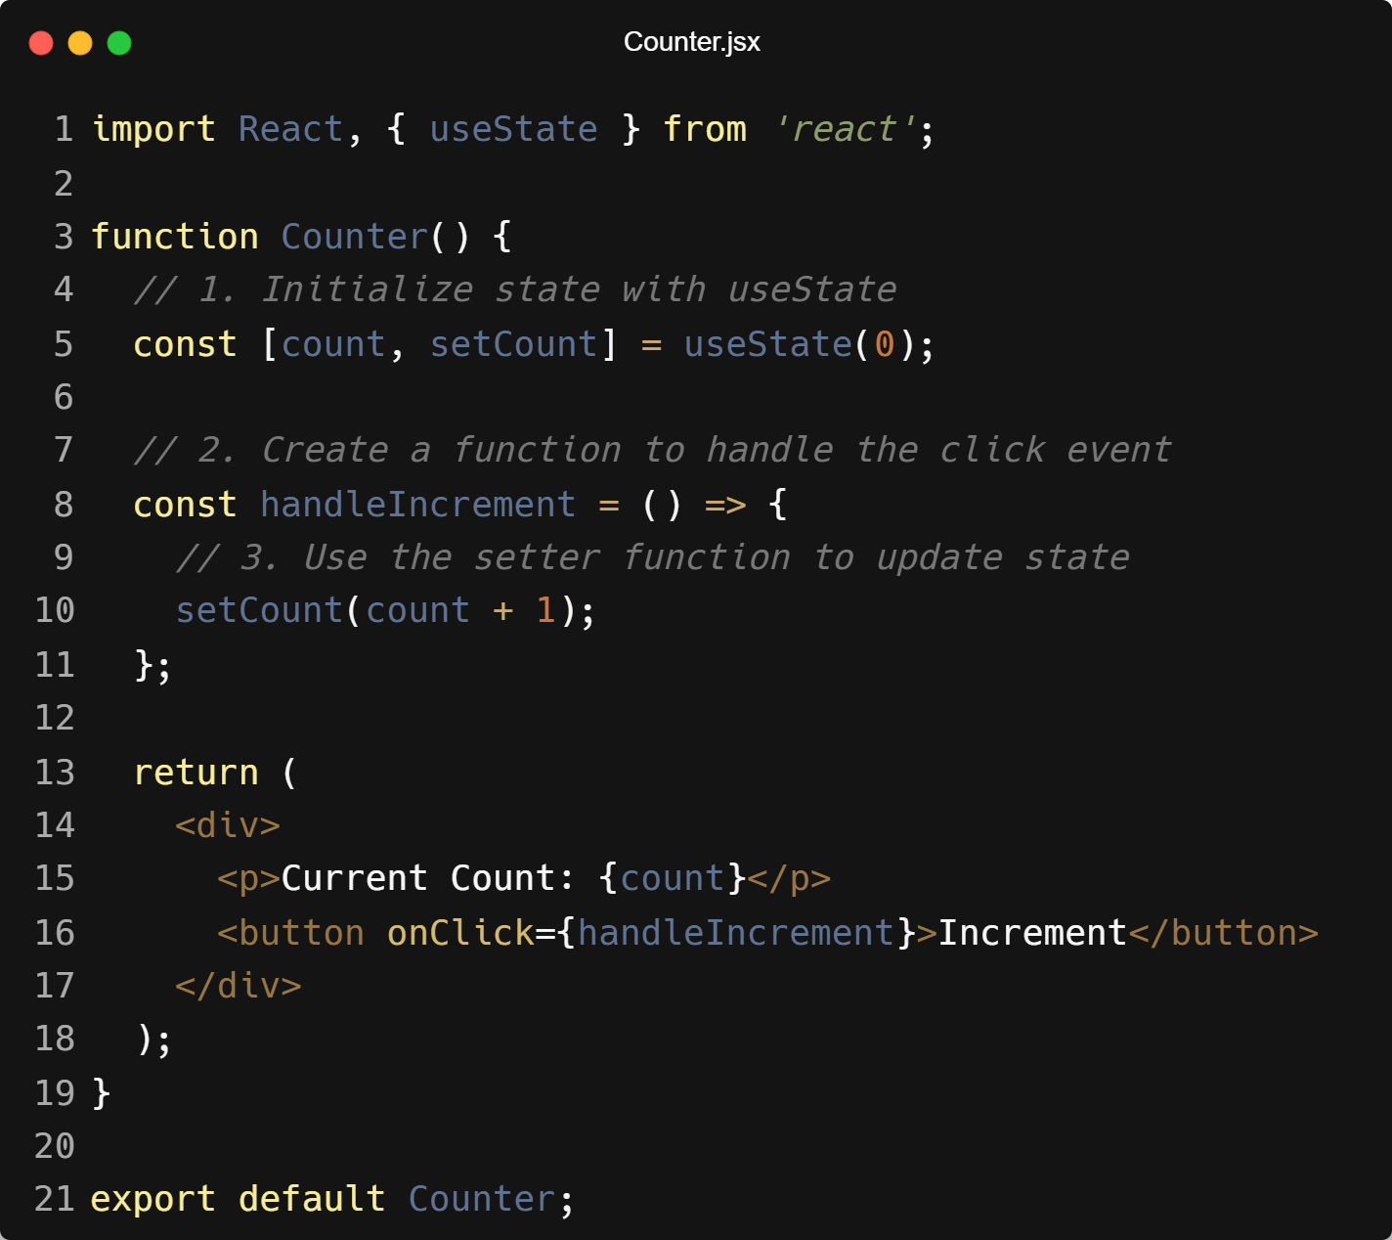
| Coding Questions
Solution :

Slide 21
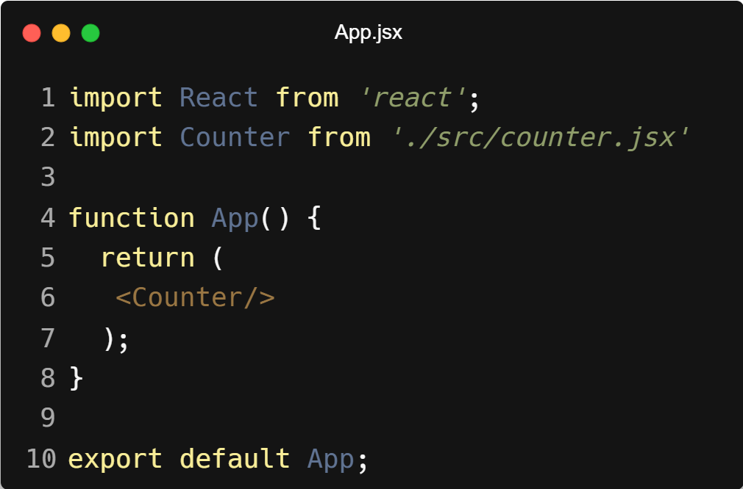
| Coding Questions
Solution :

Slide 22
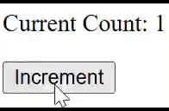
| Coding Questions
Output :

Slide 23
| Coding Questions
2. Text Input State
Task :
Create a component that has a text input field. Use useState to manage the text typed into the input. Display the current text in real-time in a <p> tag below the input.

Slide 24
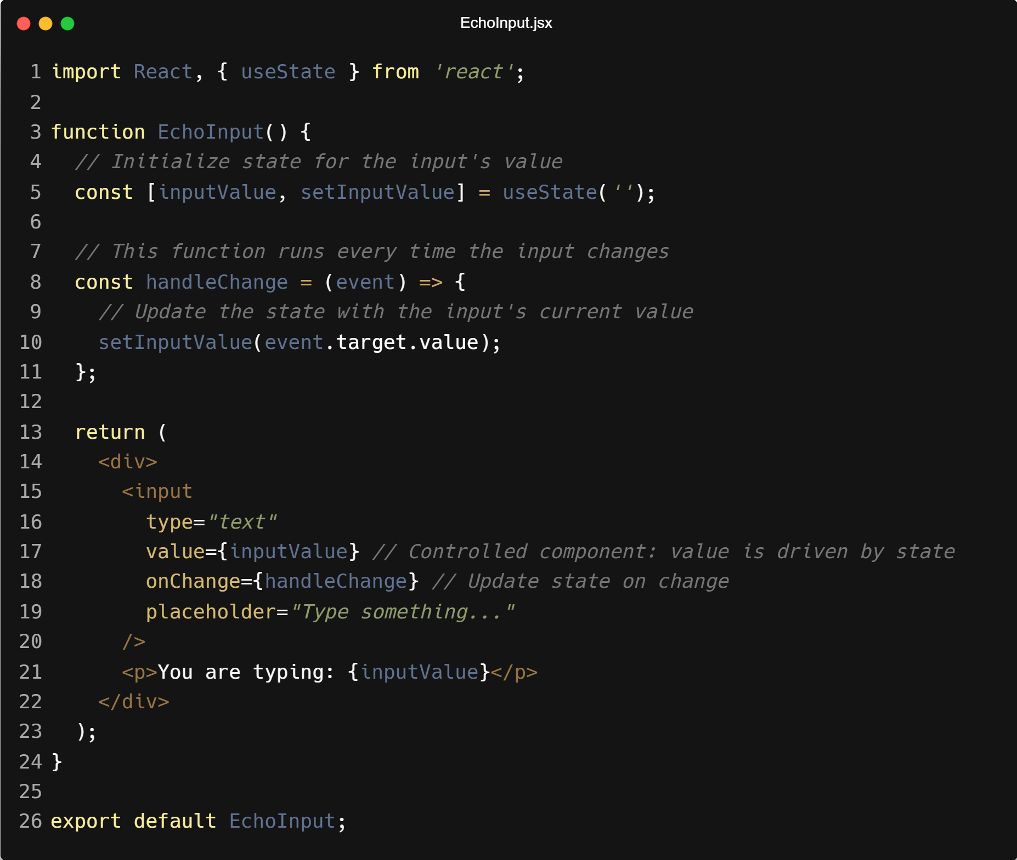
| Coding Questions
Solution :

Slide 25
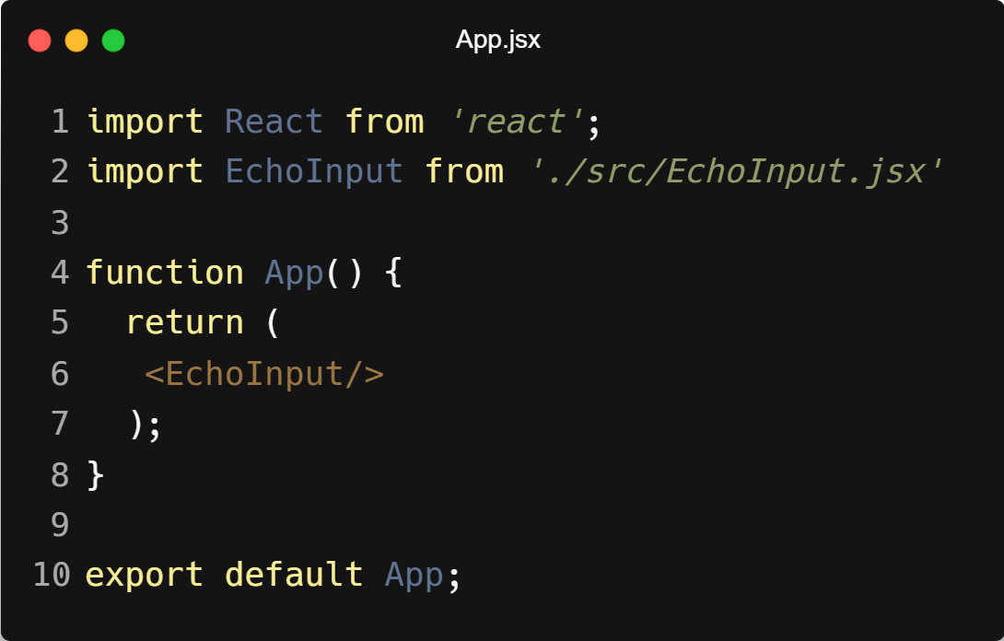
| Coding Questions
Solution :

Slide 26
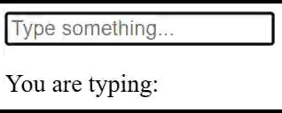
| Coding Questions
Output :

Slide 27
| Check Your Understanding
Question : What is "state" in the context of a React component?
Options : a) Data passed down from a parent component that cannot be changed.
b) A built-in JavaScript object for storing static data.
c) Data that a component owns and can change over time, causing the component to re-render.
d) A CSS framework for managing styles.
Answer : c) Data that a component owns and can change over time, causing the
component to re-render.
Explanation:
State is internal data managed by a component. When this data changes, React knows it needs to update the UI to reflect the new state.

Slide 28
| Check Your Understanding
Question : What is useState in React?
Options : a) A component
b) A prop
c) A Hook
d) A CSS class
Answer : c) A Hook
Explanation:
useState is a React Hook, a special function that lets you "hook into" React features like state and lifecycle from functional components.

Slide 29
| Check Your Understanding
Question : What does the useState Hook return?
Options : a) Just the current state value.
b) Just a function to update the state.
c) An object containing the state and an updater function.
d) An array containing the current state value and a function to update it.
Answer : d) An array containing the current state value and a function to update it.
Explanation:
useState returns an array with exactly two elements: the current state and a setter function. We typically use array destructuring to name them, like const [count, setCount] = useState(0);.

Slide 30
| Check Your Understanding
Question : What is the correct way to update a state variable named count?
Options : a) count = count + 1;
b) setCount(count + 1);
c) useState(count + 1);
d) props.count = count + 1;
Answer : b) setCount(count + 1);
Explanation:
You must use the setter function provided by useState to update state. Directly modifying a state variable will not trigger a re-render and is against React's principles.

Slide 31
| Check Your Understanding
Question : What triggers a React component to re-render?
Options : a) When a regular JavaScript variable inside it changes.
b) Every time a user clicks anywhere on the page.
c) When its props change or when its state is updated using the setter function.
d) When a new component is imported.
Answer : b) When its props change or when its state is updated using the setter
function.
Explanation:
React's rendering is primarily driven by changes in data. It re-renders a component automatically when it receives new props from its parent or when its internal state changes via a state setter function.

Slide 32
| References
MDN Web Docs : Comprehensive and official documentation for JS. 🔗https://developer.mozilla.org/en-US/docs/Web/JavaScript
W3Schools – JS Tutorial : Beginner-friendly JS tutorials with examples and interactive editors. 🔗 https://www.w3schools.com/js/
react.dev - A comprehensive, tutorial-style website that deeply explores core React concepts, including components, state, effects, and hooks, through interactive examples and in-depth explanations.
🔗https://react.dev/

Slide 33
Thanks
For
Watching
Course - Web Development - II
welcome@krmangalam.edu.in
Sohna Road,Gurugram,Haryana 122103

